Slide 1
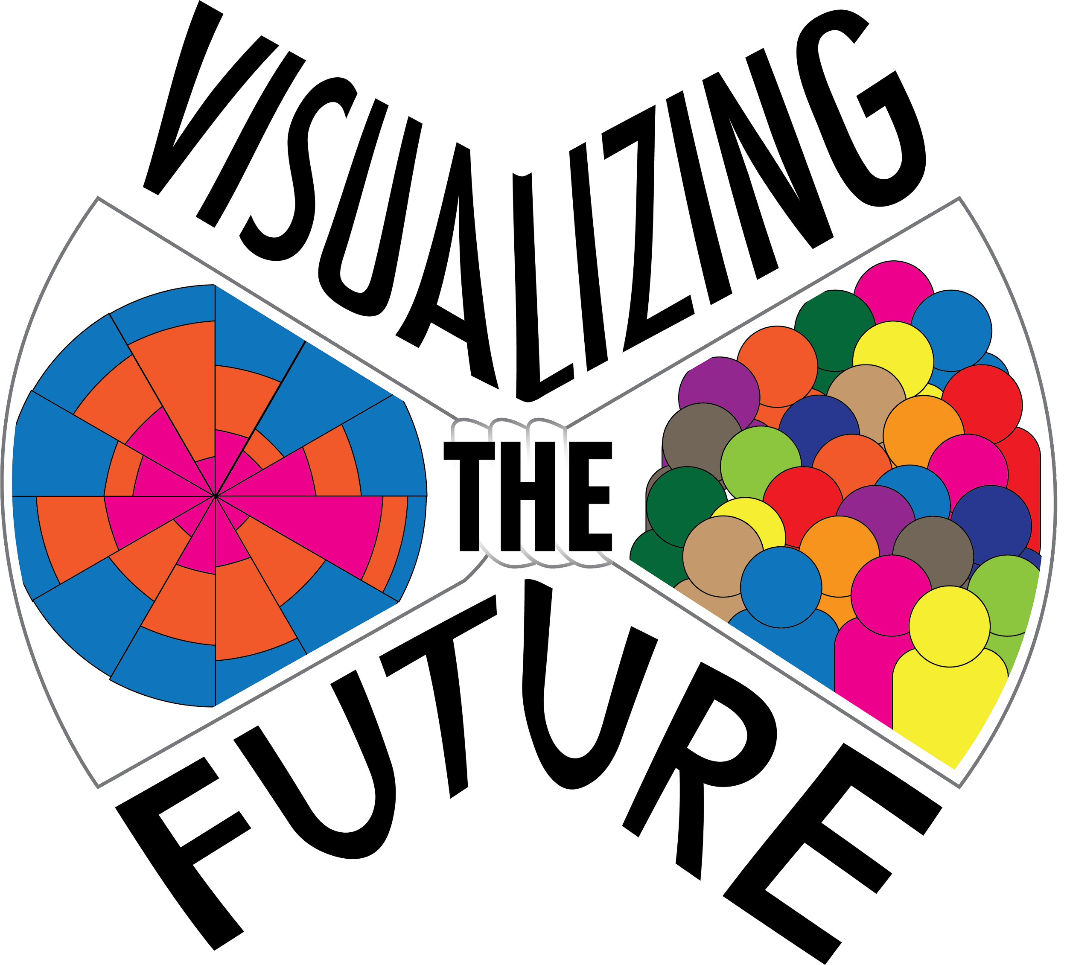
Visualizing the Future Project Report
Justin Joque
Andy Rutkowski
Angela Zoss
VTF Website

Slide 2
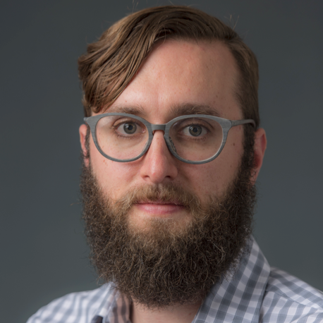
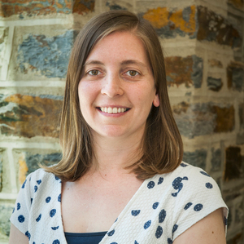
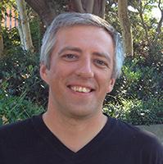
Co-Investigators
Justin Joque
Visualization Librarian
University of Michigan
Angela Zoss
Assessment & Data
Visualization Analyst
Duke University
Andy Rutkowski
Visualization Librarian
University of Southern
California
Visualizing the Future Symposia
This project was made possible in part by the Institute of Museum and Library Services, RE-73-18-0059-18.
An IMLS funded National Forum on Data Visualization in Libraries

Slide 3
A bit of background on Visualizing the Future
Notes:
This grant grew out of our desire to create a community around data visualization that focused on “teaching beyond the tool” focusing on literacy, design and communication. The three of us met at IASSIST (International Association of Social Science Information Services and Technology) and through our general work doing data visualization but felt that data visualization in libraries did not have a clear conference home. So the grant sought to assemble a cohort of fellows to engage in research and sharing knowledge about supporting data visualization in libraries.

Slide 4
Purpose of the grant
Visualizing the Future is a project to develop a literacy-based instructional and research agenda for library and information professionals with the aim to create a community of praxis focused on data visualization.
Visualizing the Future Symposia
This project was made possible in part by the Institute of Museum and Library Services, RE-73-18-0059-18.
An IMLS funded National Forum on Data Visualization in Libraries

Slide 5
Advisory Board
Nancy Bartlett (University of Michigan)
Marta Brunner, Ph.D. (Skidmore College)
Jonathan Cain (Columbia University)
Makiba Foster (African-American Research Library and Cultural Center, Broward County Florida)
Jason Griffey (National Information Standards Association)
Bergis Jules (Project Director for DocumentNow, Shift Collective)
Thomas Padilla (Center for Research Libraries)
Miriam Posner (University of California, Los Angeles)
Jennifer Vinopal (The Ohio State University)
Elaine Westbrooks (University of North Carolina at Chapel Hill)
Visualizing the Future Symposia
This project was made possible in part by the Institute of Museum and Library Services, RE-73-18-0059-18.
An IMLS funded National Forum on Data Visualization in Libraries
Notes:
Early on in the project proposal process we assembled an advisory board to guide us in designing the grant and recruiting fellows. We are incredibly grateful for the feedback they provided us.

Slide 6
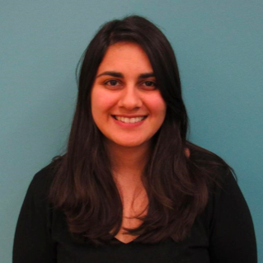
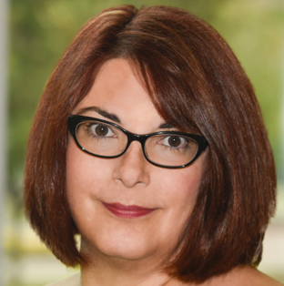
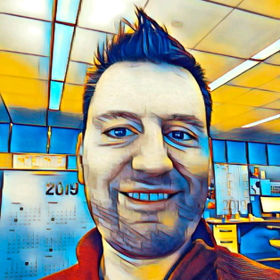
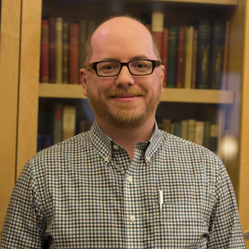
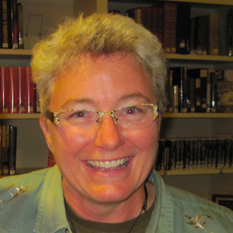
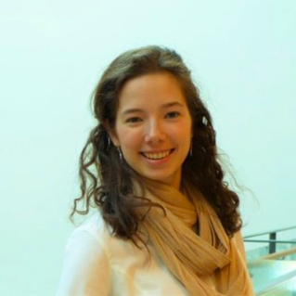
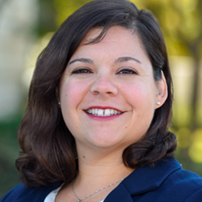
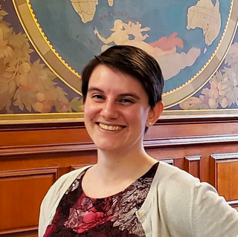
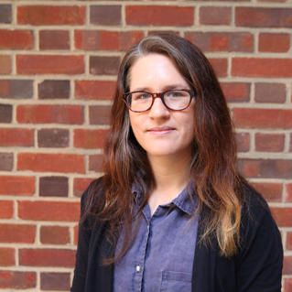
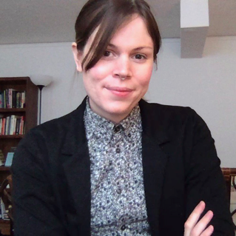
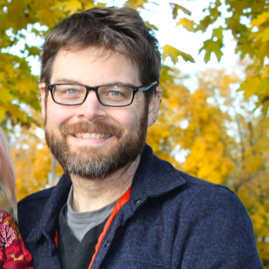
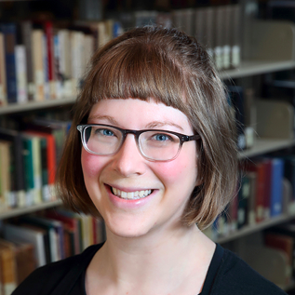
Fellows
Negeen
Aghassibake
Delores
Carlito
David
Christensen
Ryan
Clement
Sally
Gore
Tess
Grynoch
Jo
Klein
Dorothy
Ogdon
Megan
Ozeran
Alisa
Rod
Cass Wilkinson
Saldaña
Matthew
Sisk
Amy
Sonnichsen
Visualizing the Future Symposia
This project was made possible in part by the Institute of Museum and Library Services, RE-73-18-0059-18.
An IMLS funded National Forum on Data Visualization in Libraries

Slide 7
Project Activities

Slide 8
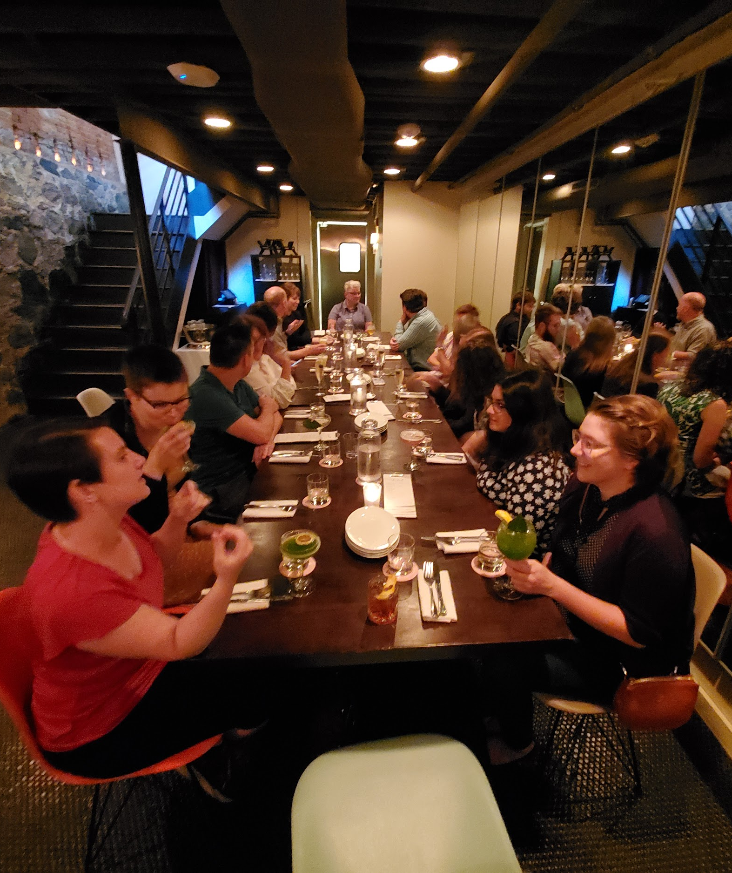
August 2019 in Ann Arbor
Lightning talks and position statements on preliminary projects
Invited speaker on ethics of virtual reality - Lisa Nakamura
Brainstorm grant deliverables
Begin project work
See full report and assessment
Notes:
At the August 2019 fellows shared the results of their initial individual research. The talks and positions statements fellows wrote before coming are available at the link in the slide as well as a full report and assessment of the meeting.

Slide 9
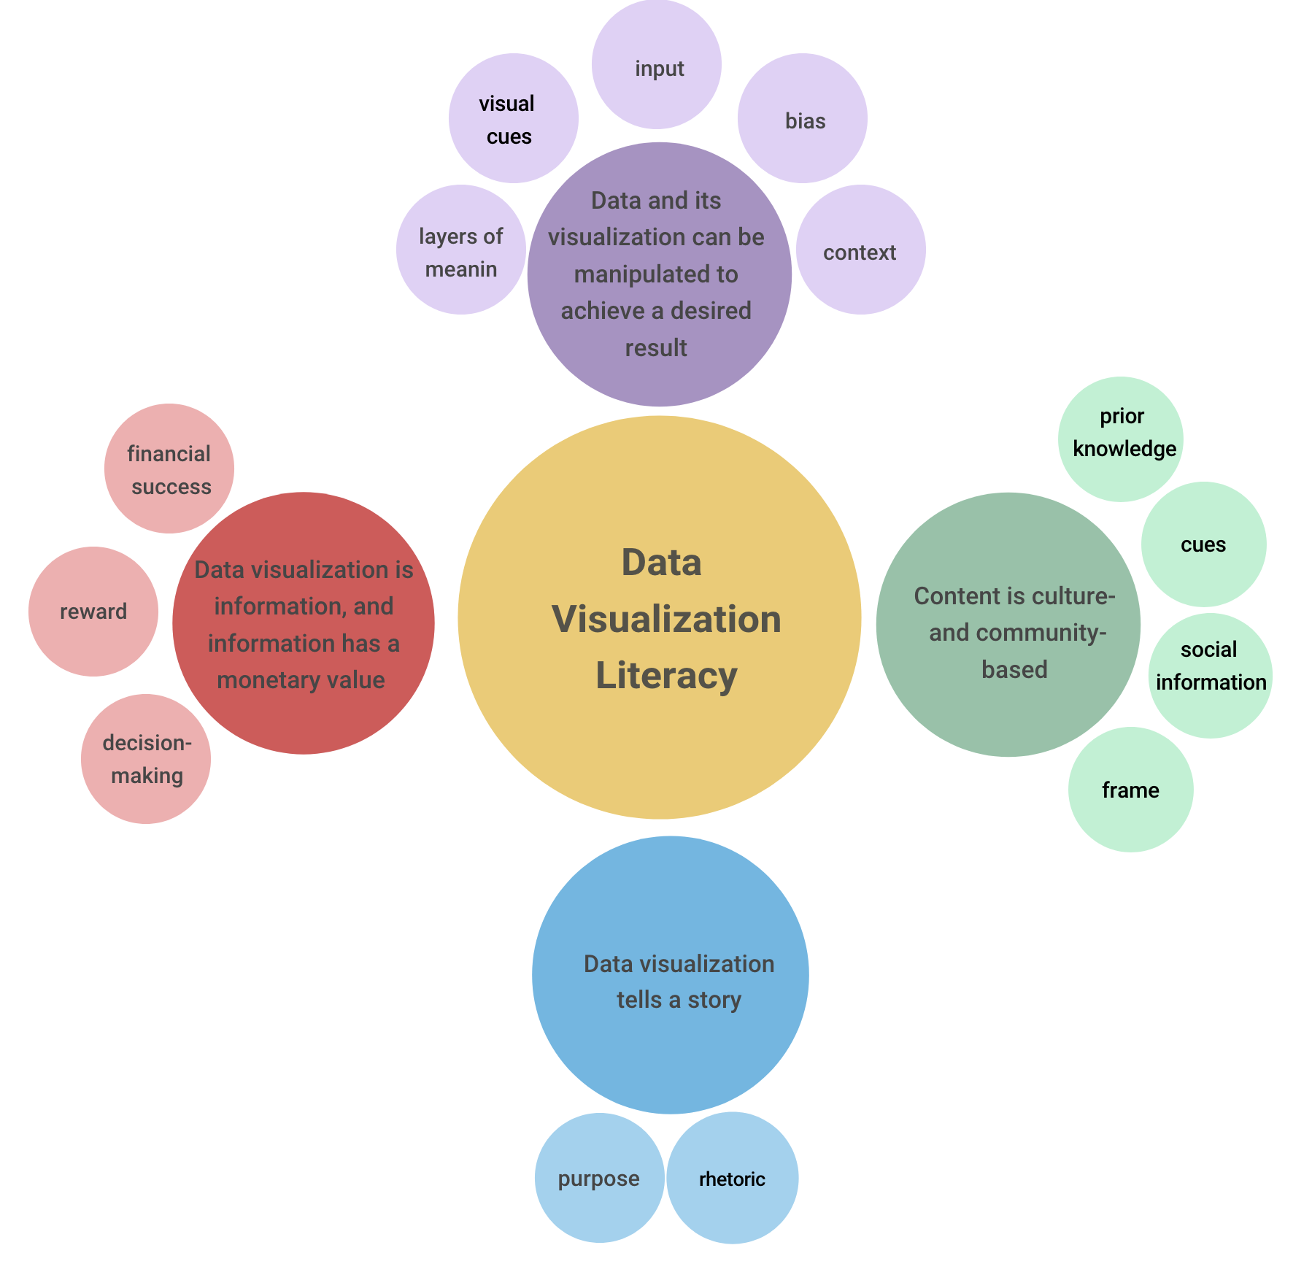
Preliminary projects
Lightning talk tomorrow
Proposed by fellows
Covered a range of topics related to critical visualization instruction
Helped fellows build and share expertise that inspired other grant deliverables
Project Proposals
Position Statements and Lightning Talks
Data Visualization Literacy Framework

Slide 10
White Paper
Why Do We Need Data Visualization Support in Libraries?
Current Environment
It’s About The People
Services
Literacies
Aghassibake, N., Joque, J., & Sisk, M. (2020). Supporting Data Visualization Services in Academic Libraries. The Journal of Interactive Technology & Pedagogy, Issue 18.
Notes:
We are in the process of writing a white paper about supporting visualization services in libraries focusing on the people involved and the literacies required for this work. We have a completed draft that we submitted to a special issue of the Journal of Interactive Technology and Pedagogy. We also intend to make a public version available for comment shortly. The sections of the white paper are listed in the slide.

Slide 11
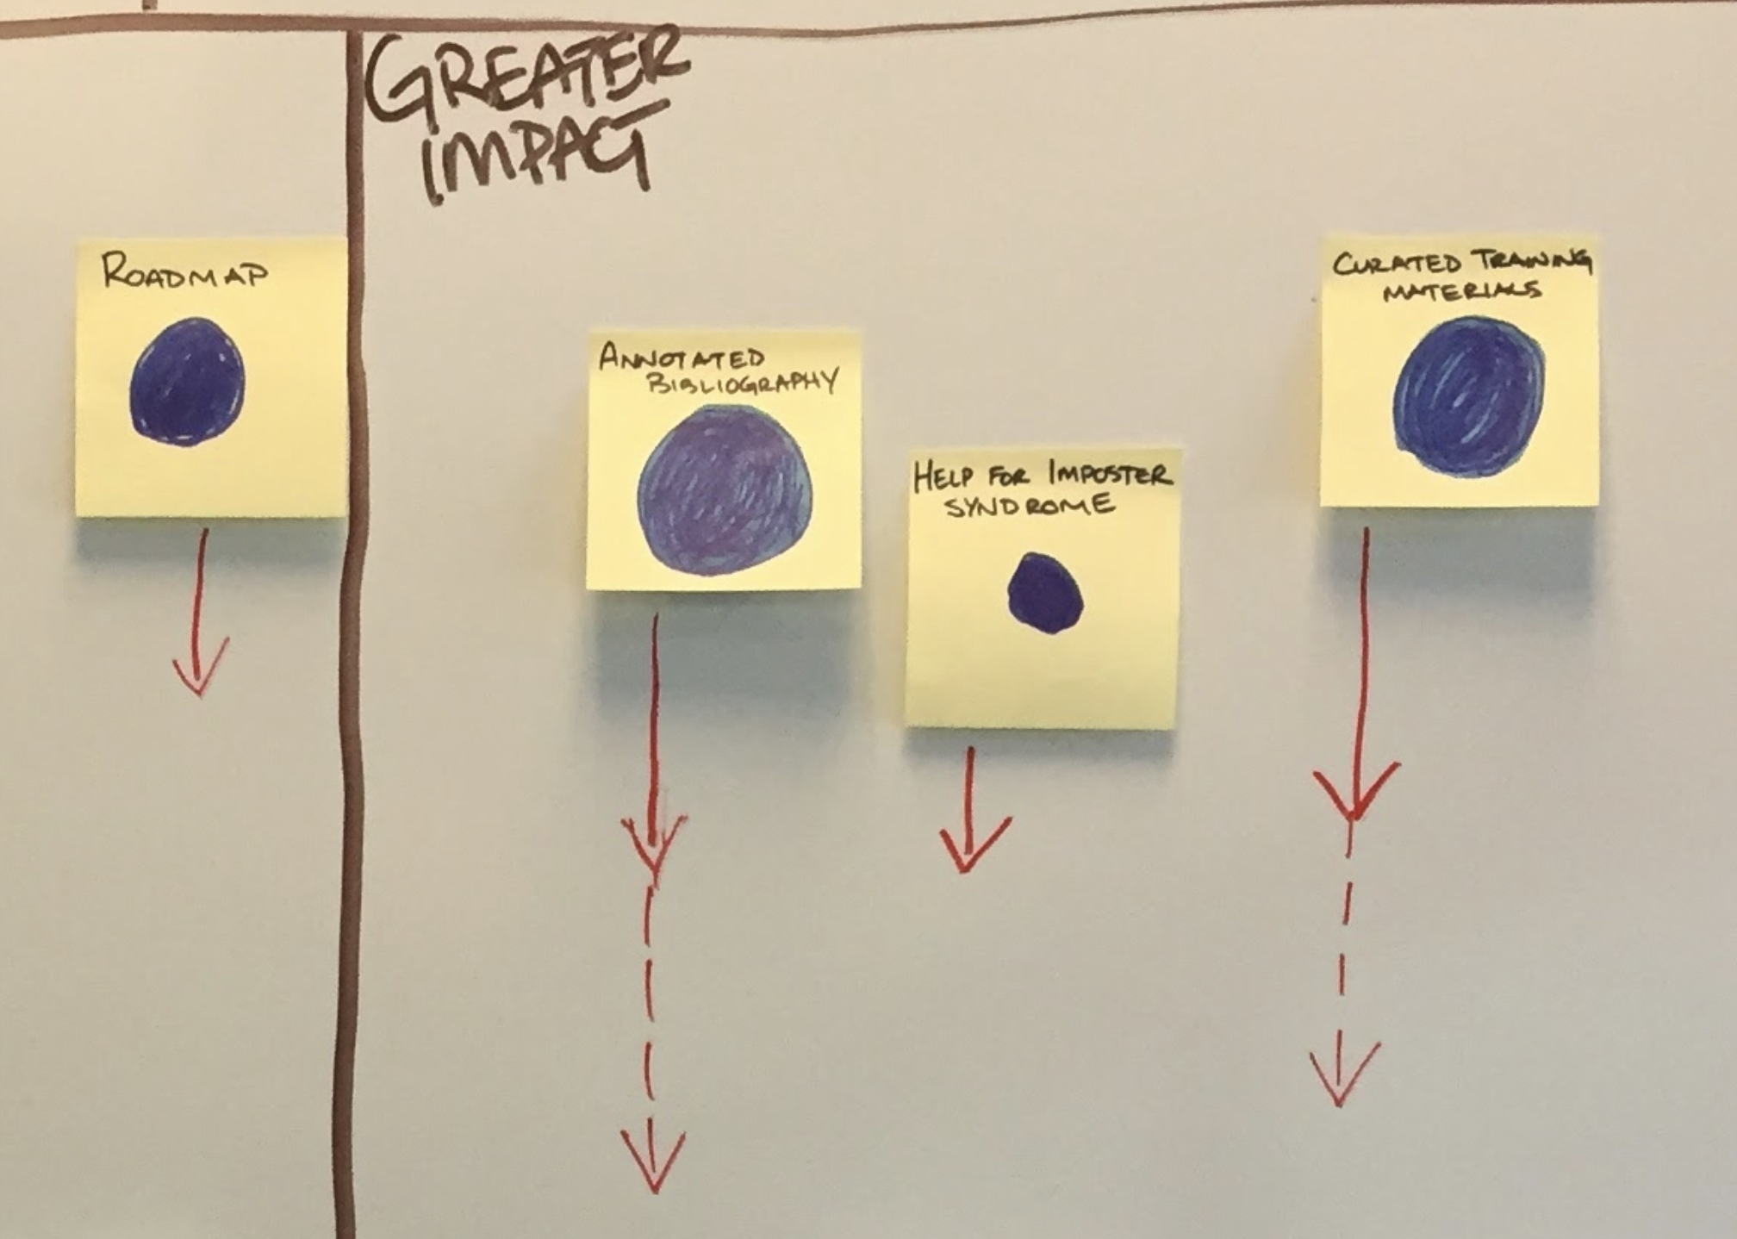
Materials for New Librarians
David Christensen and Ryan Clement
Goals: mentor and support new visualization librarians
Topics: introduction, roadmap, people important to you, and resources
Emphasizes community
Open to feedback
Materials for new data librarians
Notes:
Materials for new librarians:
Another project area that we collectively agreed upon was developing a set of materials and resources for new librarians whose main focus and responsibilities are on data and visualization.
David Christensen and Ryan Clement have been responsible for developing this project with feedback from the cohort.
The main motivation here was. Again. that for most of us we all had the shared experience of not having enough access to resources or materials that could help in getting us started in our current or previous positions.
We see that for many institutions the role of a visualization librarian or someone who supports visualization are new and often without an extensive framework or team in place. There is little or no documentation or materials to help guide or support that position, especially through the first critical months on the job.
In terms of developing the materials the roadmap and initial essential training materials were created first. Then materials about people and building a community of support both internally and externally. And then finally more curated resources that could be used later in the first year and beyond.
We envision this project as something that can be used by both new librarians and also by committees and other groups that might be trying to start up visualization services or roles that support visualization in their organizations.

Slide 12
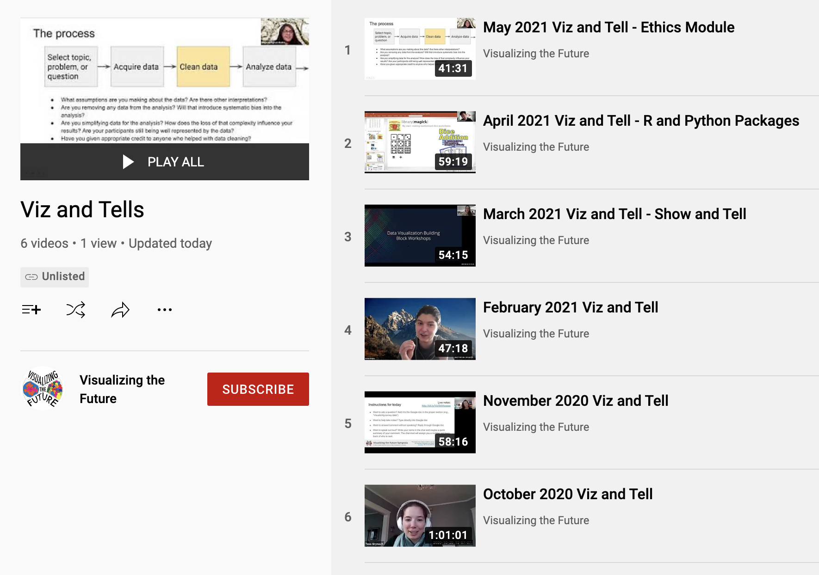
Viz and Tell
Lightning talk tomorrow
Monthly virtual meetings, hosted by VTF Fellows and Organizers
An opportunity for information professionals interested in visualization to gather, share tips, ask questions, and build community.
Recordings shared, discussion summarized with live notes, blog posts
Viz and Tell Recordings on YouTube

Slide 13
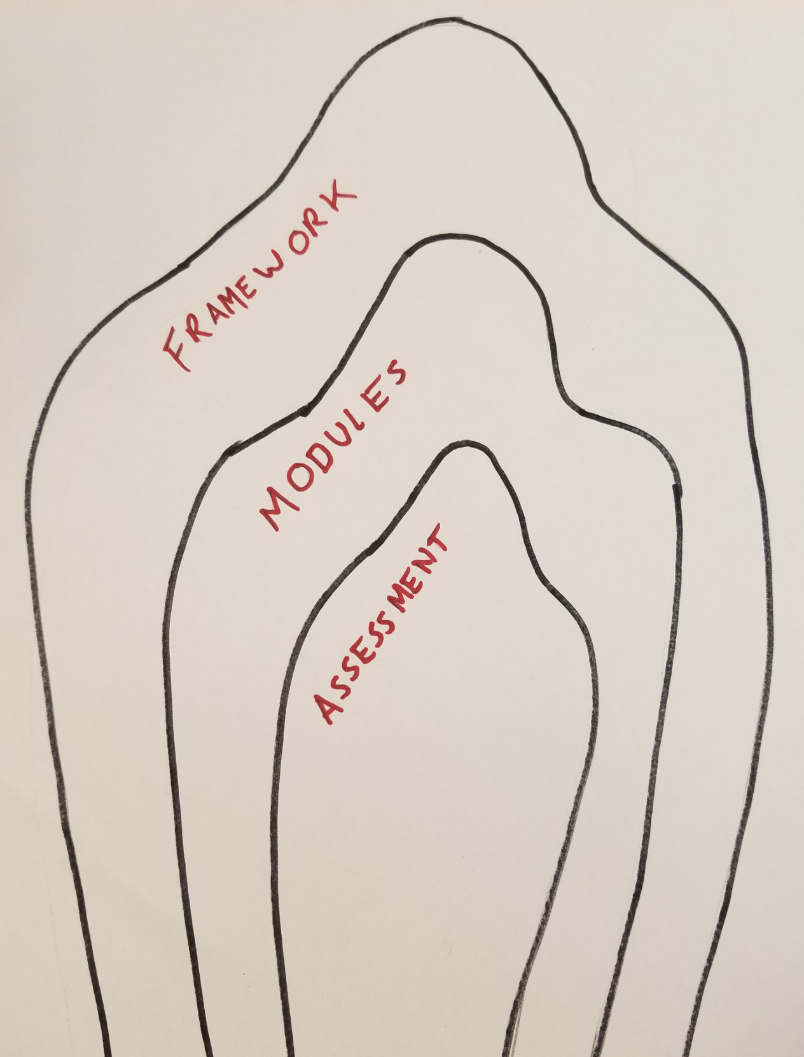
Instructional Modules
Lightning talk tomorrow
Goal to create tailored teaching materials that can be repurposed by a variety of libraries and other instructors
Focus on topics that go beyond software how-tos
Two courses developed
Ethics in Data Visualization
Data Visualization 101
Notes:
This project update is about a module that we have been working on which is about Ethics in Visualization.
To step back, one of the grant project areas is focused on developing instructional modules around topics that we collectively identified are important to visualization and libraries. These modules would be adaptable and offered as templates for librarians to use in their own teaching and training. The image you see here was from our meeting last summer which captures part of the workflow in terms of working on these modules, with first working from a framework with threshold concepts, to then working on the modules themselves, and finally thinking about assessment.
Our motivation for developing these modules was the fact that just about everyone in our cohort teaches in one capacity or another and most librarians who do visualization work are expected to teach as part of their day to day responsibilities.
There is a clear lack of resources around teaching, especially for topics that tend to fall outside of more traditional tool based approaches.
In terms of teaching a considerable amount of time is often devoted to doing research and developing from scratch workshop/materials on visualization topics.
Having adaptable and community developed modules would help to facilitate more critical approaches in teaching.
In terms of developing the modules:
We collectively identified some areas/topics. Especially ones that are not well supported currently - topics like accessibility, data visualization for social justice, participatory design and community data visualization, and others.
One of the first modules that we decided to develop is one around ethics and data visualization. In deciding on this module a survey was created to assess our priorities and that is how we arrived at starting with this Ethics Module. Which I think is even more pressing today.
Each topic is framed with threshold concepts that can be applied to broader disciplines and learning styles and levels.
Our Fellow Tess Grynoch has taken the lead on developing this first module thus far with feedback from the cohort and Delores Carlito and Dorothy Ogden have been the lead developers of the threshold concepts which will be applied to all of the modules.
The module is close to completion right now, it is in the form of a slide deck which can be easily adapted and used. It introduces the topic, has some clear learning objectives, suggested assessment questions, a bibliography, and an activity.

Slide 14
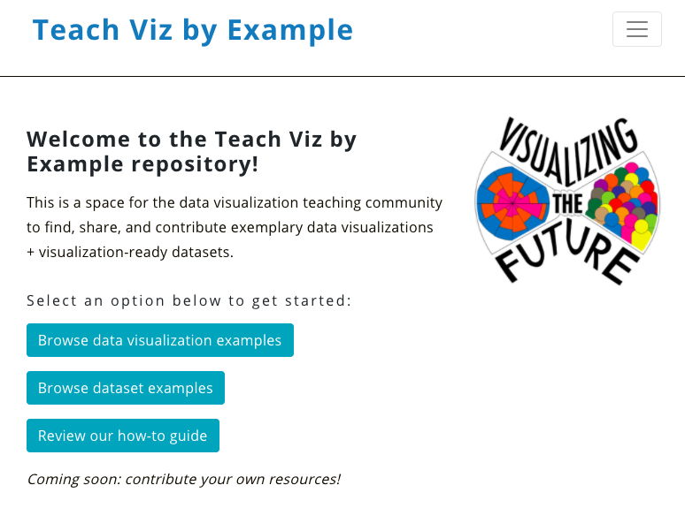
Examples Repository
Lightning talk tomorrow
Visualization instruction is based on examples of visualizations and datasets that have certain properties
Looking for examples can be a major barrier to teaching
Want a place to find and share examples, including annotations about what makes them useful for teaching
Teach Viz by Example repository

Slide 15
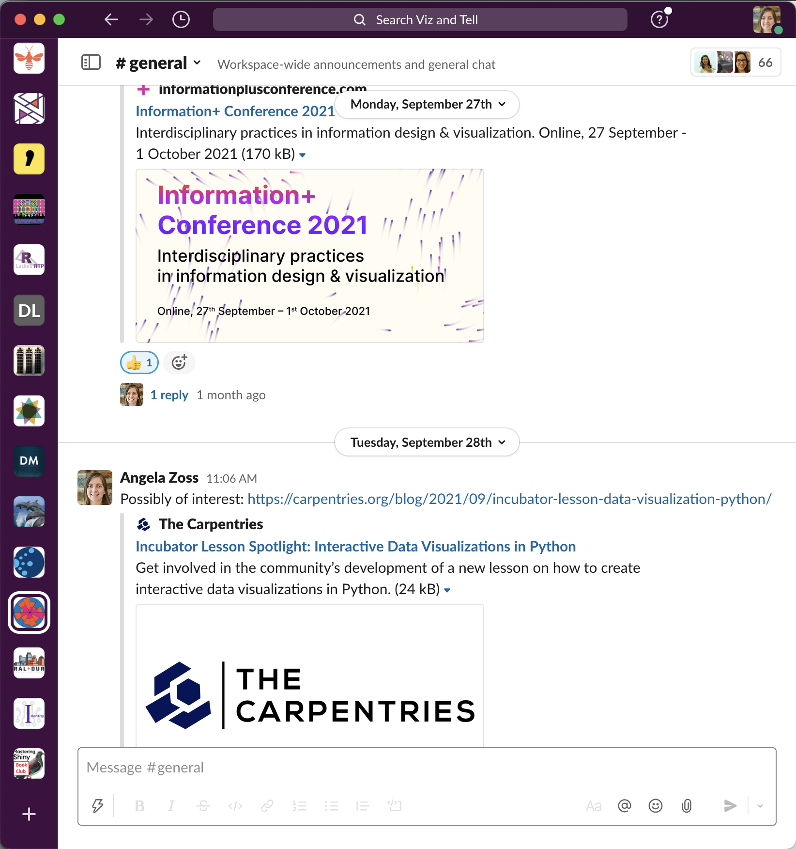
Communication and Community Organization
Website
Mailing list
Slack
YouTube
Public events (e.g., Viz and Tells, Symposium)

Slide 16
Reflections
Notes:
Thank you Angela and Justin.
We wanted to now spend a few moments and reflect on our work, share some of the ongoing challenges, lessons learned and move onto some next steps.
One incredibly important reflection from all of us, and Angela really highlighted this, is how open, casual discussions between the the three organizers as well as with all the fellows have been some of the most rewarding aspects of this work. Having a space for monthly meetings with the fellows and weekly meetings with organizers has allowed for a deeper and richer conversation on topics that are important to us and this is something that is even hard to do sometimes in our own work environments with other colleagues. It is really one of those things that is very hard to quantify but something that really changes your perspectives and will have a long lasting impact years after this grant is finished up.
In part these conversations have also served as inspiration to begin our Viz and Tell sessions -- which we have a lightning talk and an entire session on tomorrow.
We hope to encourage even more of these with our Viz and Tell sessions (see details later on in slideshow).
It has also been rewarding to adapt and work with the Fellows throughout the grant period and let them help to shape and guide the the goals and outputs of the grant.
As organizers we spend a lot of time thinking through what kind of infrastructure and support will be best for the group and the work we need to do, but the fellows have really brought a lot of creativity and helped shape the work into something that we think will really have an impact.
One other thing that has been incredibly important personally and professionally for us as organizers has been considering our work in the context of COVID and this ongoing pandemic. One of the aims of this grant has been to facilitate dialogue and conversation among librarians doing work in visualization and to create a community in which we can support our work. What I think I might be most proud of in our grant work thus far is in how we came together to be supportive, flexible, and recognize the seriousness, the difficulties, and the challenges that we have all been going through during these past few months and that we will continue to go through.
We have as a team and cohort grown together and it has been inspiring to be able to work with such a caring and thoughtful group of individuals.

Slide 17
Ongoing challenges
Connections to public institutions
Collaborations with other groups
Reserving/protecting time for this work
Supporting the individual projects of the fellows
Notes:
So we have had some really compelling challenges that are worth noting and sharing. One of the biggest hurdles has been to make meaningful connections with public institutions. Ultimately there are many reasons why we have not been as successful doing this as we might have wanted to be but this is one that we kept returning and trying to find inroads and just had a hard time realizing.
Another, and this is quite related, is also going beyond our cohort and making collaborations and partnerships with other groups.
I think we all struggled at times with reserving and protecting time for this grant work. Managing a grant and having a cohort almost exclusively of mid or early career professionals is a difficult reality especially when other demands - both personal and professional - where constantly present.
Finally we feel that we need to acknowledge that as co-PIs we had really hoped to facilitate our fellows initial project work. In a way we traded priorities for group work over individual projects but one of the exciting aspects of this grant was to make space for fellows to do personal research and that was not quite realized in the way that we had hoped.

Slide 18
Lessons learned
No pandemic
Build connections - learn from each other
Accessibility
Didn’t necessarily accomplish everything we wanted, but did react flexibly and work with fellows to decide priorities
Position turnover will affect people’s abilities, but the grant may also be encouraging people to grow in new ways
Notes:
So how about some lessons learned.
We can start quite seriously but lightly, in that try not to do a grant during a pandemic.
We can talk more about this during the Q/A if folks have specific questions here but we can leave it at that the pandemic really left an impact on this grant because we had to react and refigure so many of our outcomes and objectives because of it.
Though we might have not been able to do collaborations/partnerships beyond our cohort as much within the cohort we have a really active and connected community where we really constantly learn from one another and work together.
One theme of the grant work that has emerged and we have all become more attuned to it and is making our work more accessible. This was something that many of the fellows were interested in in a practical way in visualization work and creating visualizations, but now with this real emphasis on online work etc. our idea of accessibility has been broadened I think and also just has become much more practical and real.
Being flexible. We all say that we want to be flexible and reactive etc. but we through repetition and necessity have gotten really good at working together to repriortize goals, make projects tangible, and broaden and try to make our impact as meaningful and vital as we could.
One last interesting lesson is because of the length of the grant we have had fellows in our cohort accept new positions and really grow professionally and personally. We hope in part that the grant was able to help and support some of these developments. So again, thinking about ways in which this grant impacts our work that

Slide 19
Next steps
Join us for the Viz and Tell (tomorrow, 9-9:50am Pacific, 12-12:50pm Eastern)
Instructional modules are live
Data Visualization 101
Ethics in Data Visualization
Notes:
So very quickly, before we get to some Q/A time we wanted to share some immediate next steps.
Namely we will have a Viz and Tell about Viz and Tellsl where we will talk more about how this has been one of the ways that we have been creating and supporting a visualization community and what will be the next steps for these discussions now that the grant is nearing completion. We really hope to find a future for this activity with you all here!
Also we have a Youtube channel, we have lots of videos around two topics/themes - Data Visualization 101 and Ethics in Data Visualization. We would love for you to interact with them, use them, give us feedback on them.

Slide 20
Q&A
Website:
https://visualizingthefuture.github.io/
Email:
visualizingthefuture@umich.edu
Visualizing the Future Symposia
This project was made possible in part by the Institute of Museum and Library Services, RE-73-18-0059-18.
An IMLS funded National Forum on Data Visualization in Libraries
Notes:
So now lets take a minute, pause and reflect, and people can feel free to enter questions via the chat or please raise your virtual hand and we can start a conversation for the next few minutes.
Please see our video and blog post for a summary of the Q&A.
The blog post and video will be shared on our website (https://visualizingthefuture.github.io/).
For west coast folks please stick around! We will do a quick meet and greet and get to know each other right after this conversation.

